Slide 1
Front End Engineering-I Project
Team Details: team no- 14
PRIYANKA CHAURASIA(2310992499)
PRIYANSHU MITTAL(2310992500)
PURVA BATRA(2310992501)
RAVNEET KAUR(2310992507)
Faculty Coordinator: mr. SHIVAM Singh
:
Chitkara University Institute of Engineering and Technology,
Chitkara University, Punjab

Slide 2
Table of Contents
Sr. No | Content | Page No.
1. | Introduction | 03
2. | Problem Statement | 05
3. | Technical Details | 06
4. | Key Features | 07
5. | Project Highlights | 08
6. | Conclusion | 08
7. | References | 11

Slide 3
Introduction
mental health website
GROUP MEMBERS:-
PRIYANKA CHAURASIA(2310992499)
PRIYANSHU MITTAL(2310992500)
PURVA BATRA(2310992501)
RAVNEET KAUR(2310992507)
Purpose:
The primary purpose of our mental health website is to provide a comprehensive, accessible, and supportive platform where individuals can explore their mental well-being, access valuable resources, and seek professional help when needed. In a world where mental health challenges are increasingly prevalent, our website serves as a bridge to break down the barriers of stigma, isolation, and confusion surrounding mental health issues.

Slide 4
Goals of the Mental Health Website
Raise Awareness: Educate users about mental health and reduce stigma through accessible information.
2. Provide Resources: Offer a centralized hub for self-assessments, coping tools, and professional services.
3. Empower Users: Help individuals take control of their mental well-being with self-assessments and personal journaling features.
4. Connect to Professionals: Facilitate easy access to mental health professionals and support services.
5. Encourage Early Action: Promote prevention and early intervention through educational content and assessment tools.
6. Foster Community: Build a safe, supportive space for open mental health discussions.

Slide 5
Problem Statement
STATEMENT OF PROBLEM:-
"In today’s fast-paced and often stressful world, mental health issues are increasingly prevalent, yet access to reliable information and support remains limited. Many individuals struggle with conditions such as anxiety and depression but face barriers like stigma, lack of resources, and inadequate awareness. This leads to feelings of isolation and prevents people from seeking help or understanding their mental health better. Our mental health website aims to address these challenges by providing a comprehensive, accessible platform that offers valuable resources, self-assessment tools, and pathways to professional support, ultimately fostering a greater understanding and prioritization of mental well-being."

Slide 6
Technical Details
1. Frontend: - HTML/CSS/Java ScripT: Used for structuring and styling web pages and enhancing interactivity. - Responsive Design: Ensures the website works well on different devices (e.g., Bootstrap, Tailwind CSS). - Frameworks : Angular, React, or Vue.js for dynamic content and user interactions.
HTML:- HTML (HyperText Markup Language) is the standard language used to create and structure content on the web by defining elements like headings, paragraphs, links, and images.
CSS:-CSS (Cascading Style Sheets) is a style sheet language used to control the appearance and layout of web pages by applying styles like colours, fonts, and spacing to HTML elements.
JAVASCRIPT:-JavaScript is a programming language used to create dynamic and interactive content on websites, enabling features like animations, form validation, and real-time updates.

Slide 7
Key Features
Here are some key features of a healthcare website:
Self-Assessment Tools: Interactive questionnaires to help users evaluate their mental health status, such as anxiety, depression, and stress levels.
Resource Library: A comprehensive collection of articles, guides, and videos on various mental health topics, coping strategies, and treatment options.
Personal Journal: A secure space for users to reflect on their thoughts and feelings, track their progress, and document their mental health journey.
News and Updates: A section dedicated to the latest developments in mental health research, treatments, and advocacy efforts.
User-Friendly Interface: An intuitive design that ensures easy navigation and accessibility for all users, regardless of their tech-savviness.
Privacy and Security: Strong data protection measures to ensure user privacy and confidentiality when accessing resources and sharing personal information.

Slide 8
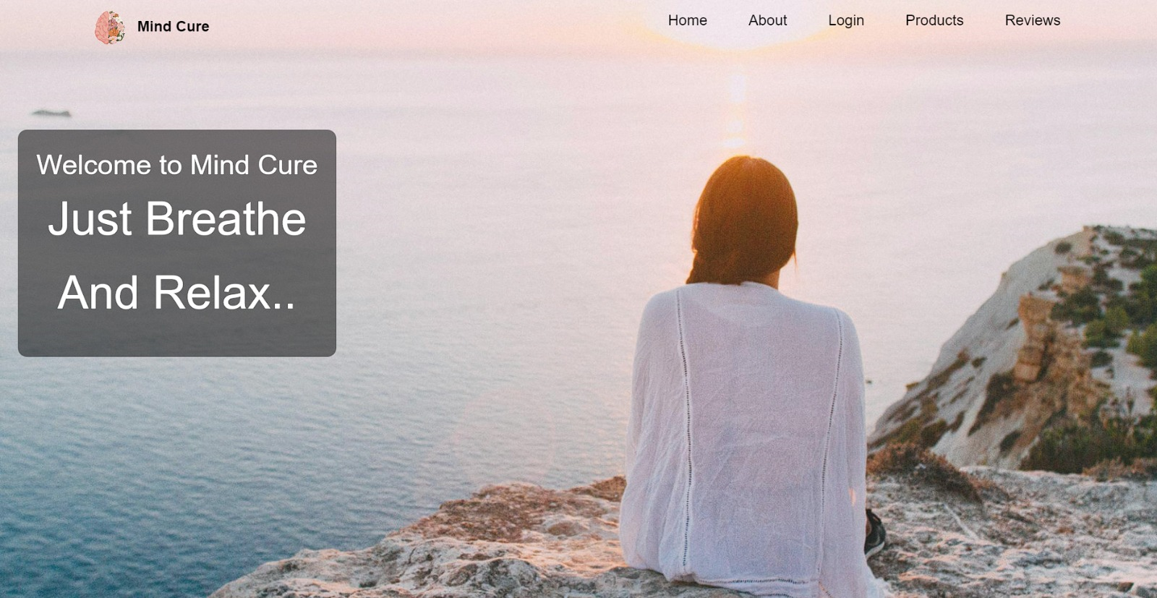
PROJECT HIGHLIGHTS
1. Home-page

Slide 9
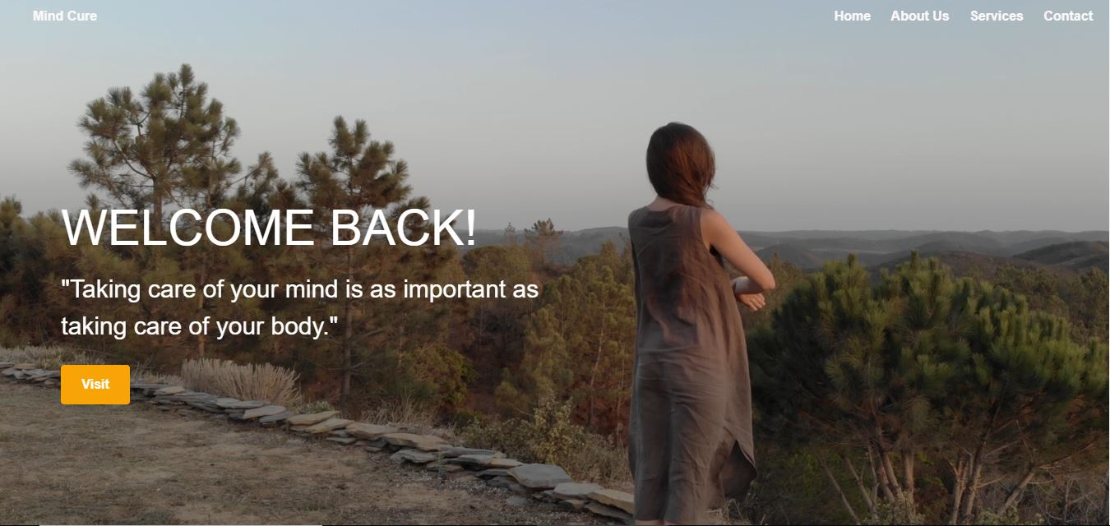
PROJECT HIGHLIGHTS
2. Landing Page

Slide 10
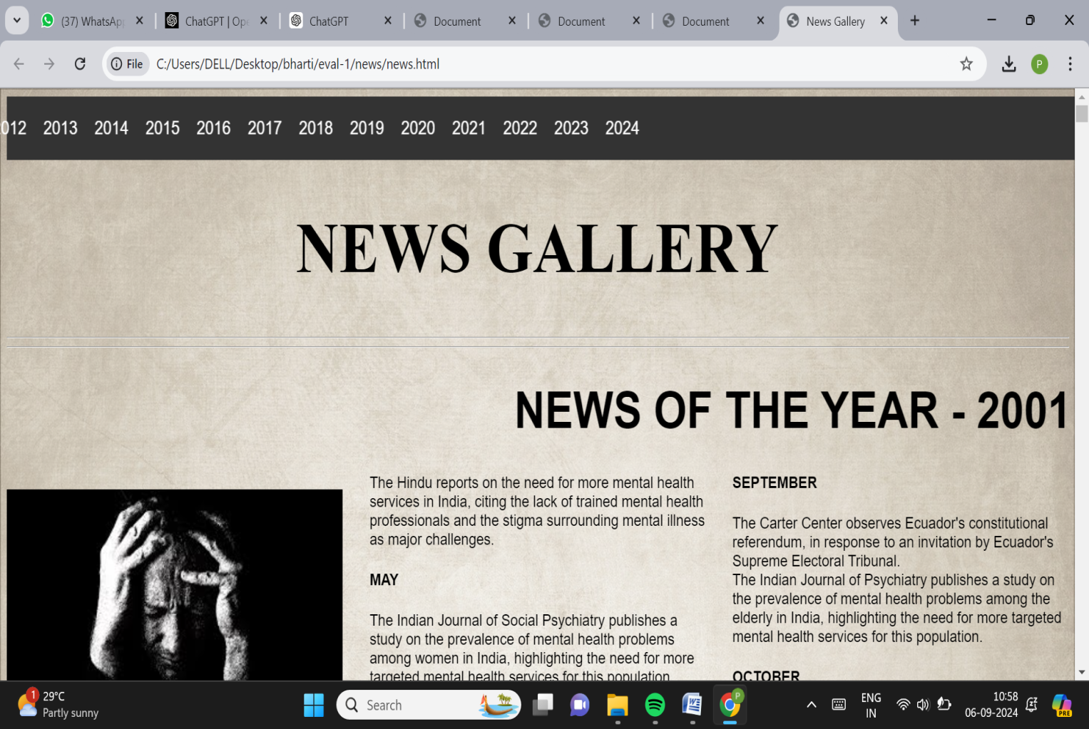
PROJECT HIGHLIGHTS
3. Mental Health News Gallery

Slide 11
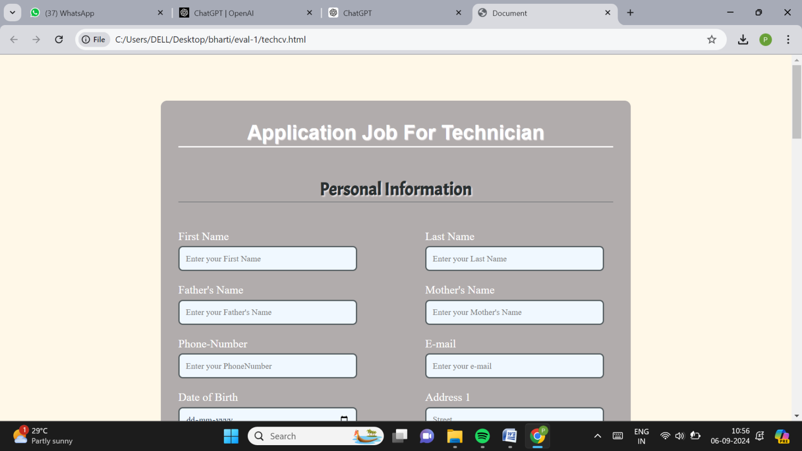
PROJECT HIGHLIGHTS
4. Job Application for Technician Roles

Slide 12
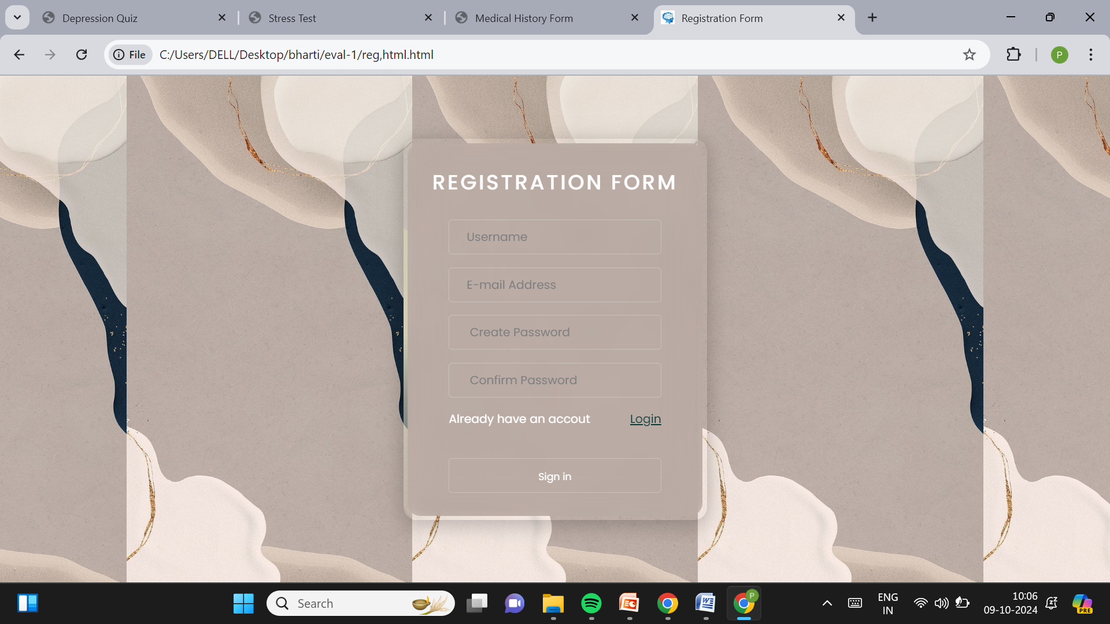
PROJECT HIGHLIGHTS
Registration Page

Slide 13
Conclusion
At Mental Health Website, our commitment is to provide you with the most reliable, up-to-date information and resources to support your health and well-being. Whether you’re seeking guidance on specific medical conditions, exploring treatment options, or looking for trusted healthcare providers, we are here to assist you every step of the way. Your health is our priority, and we strive to empower you with the knowledge and tools necessary to make informed decisions. Explore our comprehensive resources, connect with our expert team, and take proactive steps towards a healthier future.Thank you for visiting our Mental Health Website. We look forward to supporting your journey to better health.

Slide 14
References/Links used
https://mydocsy.com/
https://mindcure.care/
https://timesofindia.indiatimes.com/archive.cms
https://www.fitness.com
https://in.pinterest.com/
https://cssgradient.io/

Slide 15


